Slide 1
Problem Theme : Build a career tracking platform for skilled youth
Team Number 3
Date 25-08-2025
Team Members Name:-
Divyanshi
Aadi Vinayak S
Utkarsha Budhvant
Tanushree Naik
Humanshu Ise
Atharv Khatavkar
Manasi Phand

Slide 2
Problem Statement brief:
Y4D lacks a transparent and scalable system for tracking long-term employment progress of placed students.
There is no centralized, role-based portal where students, clerks, and administrators can collaboratively update, verify, and monitor career credentials and employment outcomes.
This absence leads to poor data quality on student career progress and credentials.
Delayed interventions occur because current information is difficult to access and validate.
Inefficient measurement of program impact results from fragmented and manual processes.

Slide 3
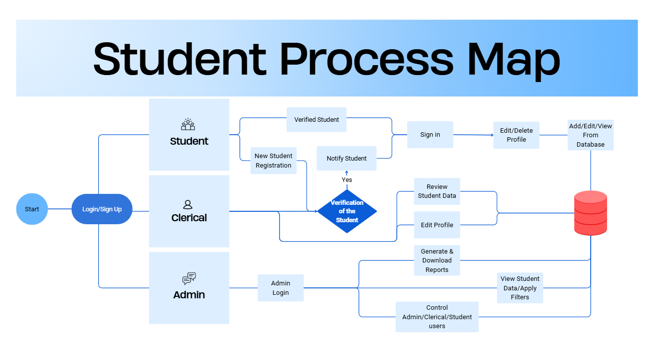
Solution Overview:
Architecture

Slide 4
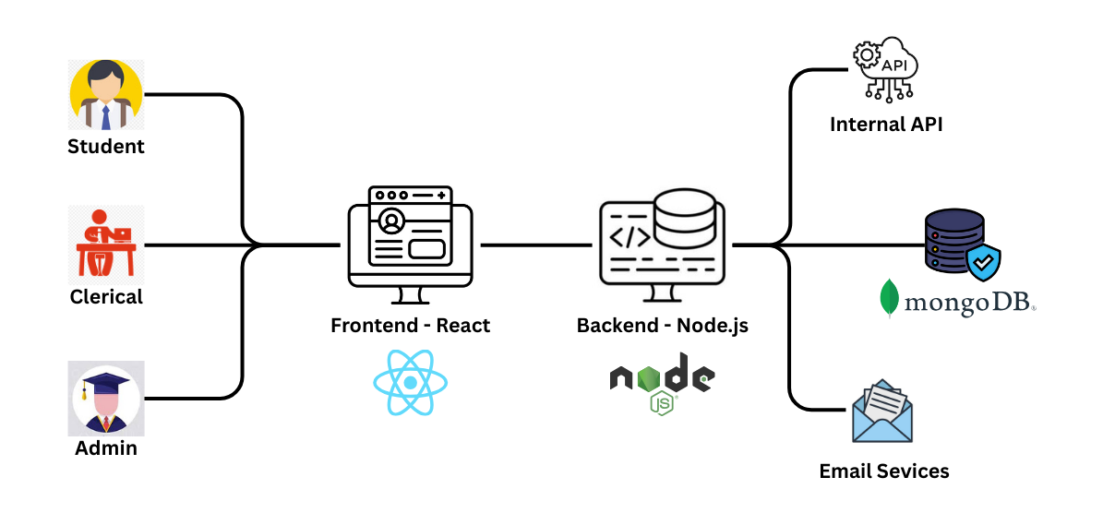
High Level Diagram

Slide 5
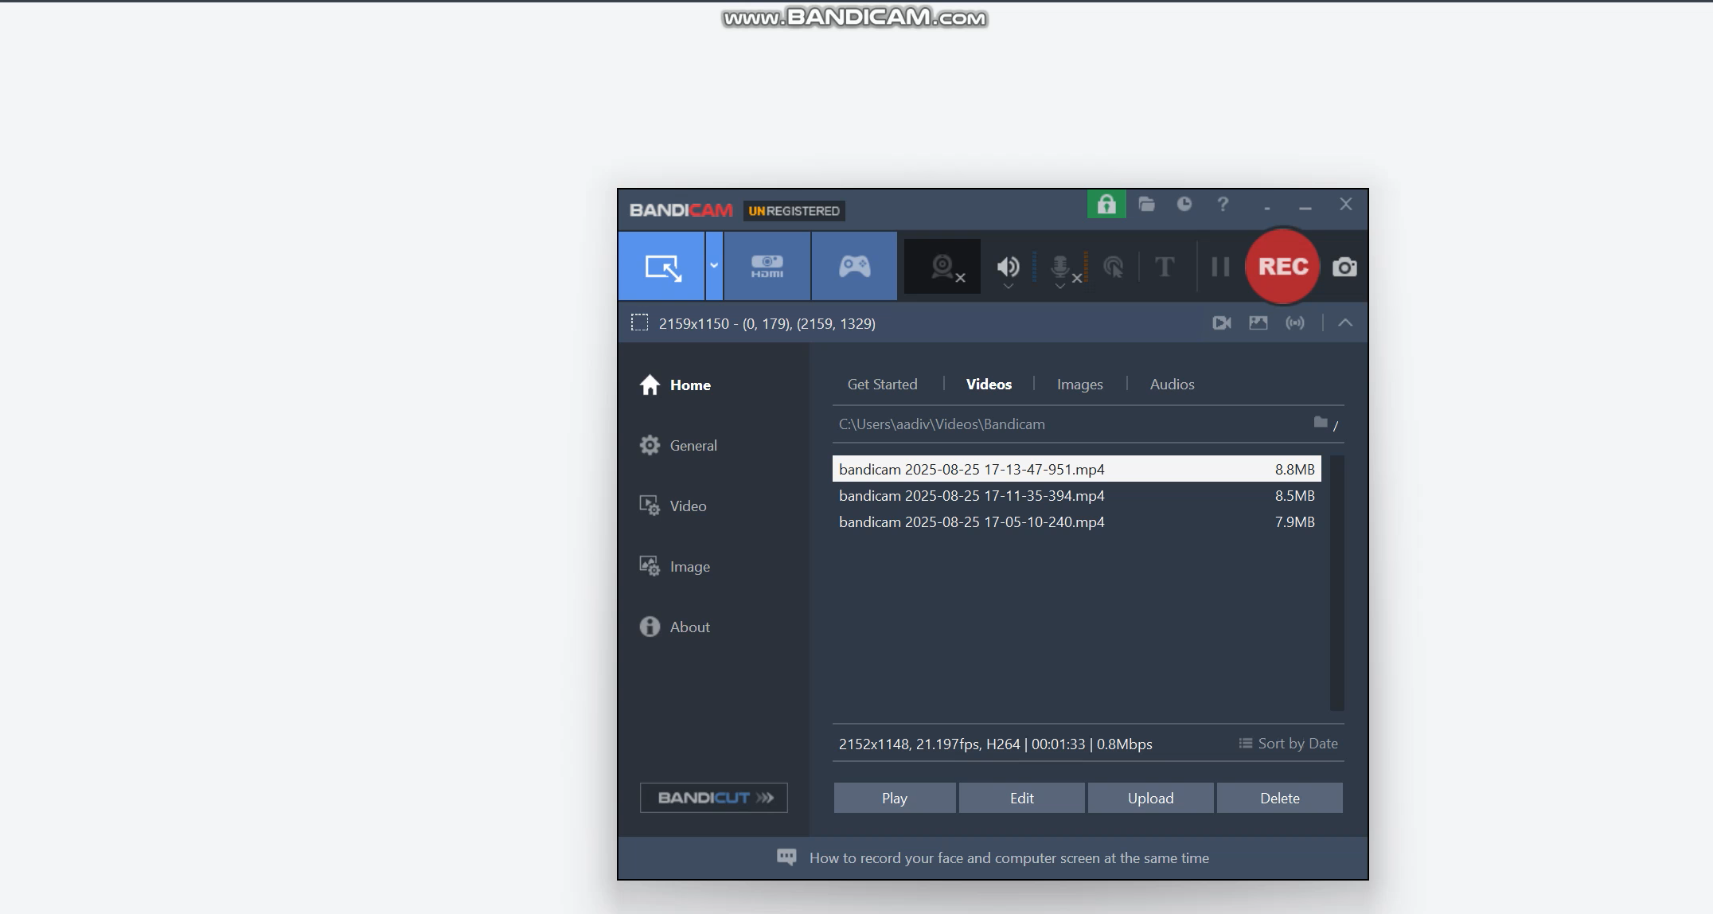
Demo/Prototype

Slide 6

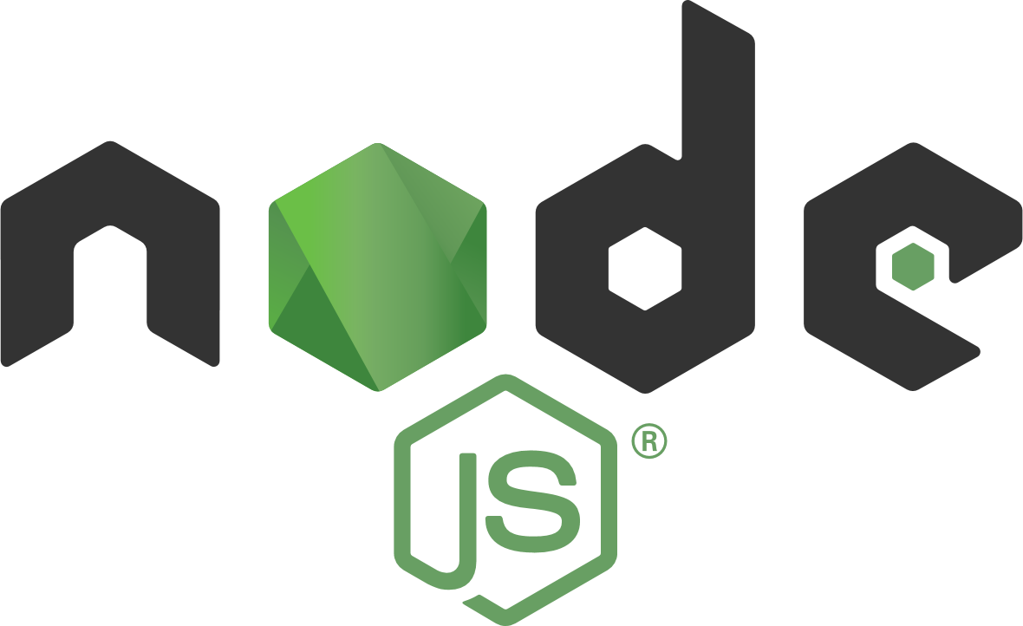


Technology Stack
We used React.js for the frontend to build a dynamic and responsive user interface compatible with PC, tablet, and mobile devices.
The backend is built with Node.js and Express.js, responsible for handling API requests, business logic, and role-based authentication for students, clerks, and admins.
MongoDB is our database choice, providing a flexible NoSQL storage for student profiles, documents, and employment data with support for secure encryption.
User authentication is managed using JWT (JSON Web Tokens) to ensure secure and seamless login and session handling.
The system implements role-based access control to maintain data privacy across different user types.
Frontend: React.js + Tailwind CSS
Backend: Node.js + Express
Database: MongoDB
Auth & Security: JWT

Slide 7
Impact
Scalability & Integration
The MERN stack architecture supports easy horizontal scaling to accommodate growing user numbers across students, clerks, and admins.
Modular RESTful APIs enable seamless integration with external systems, such as government employment portals or partner training platforms.
Cloud deployment in future phases will provide elastic resources for high availability and performance during peak
Additional Use Cases
Leveraging the portal’s data, predictive analytics can be developed to identify at-risk students and recommend timely interventions.
The platform can be extended to include employer feedback and job market insights to enhance job matching quality.
Integration of skill certification verification and connection with learning management systems can broaden the ecosystem.

Slide 8
Future Scope
1.Integration with AI/ML for career prediction and dropout risk analysis.
2.Advanced data visualization dashboards for real-time insights.
3.Automated document verification using OCR & blockchain for authenticity.
4.Expansion to include alumni networking and mentorship features.
5.Potential to scale as a nationwide digital student career tracking system.

Slide 9
Q&A

